Slide 1
BOLT: Anonymous Payment Channels for Decentralized Currencies
Charlie Liu

Slide 2
What is BOLT?
B – Blind
O – Off-chain
L – Lightweight
T - Transactions

Slide 3
So what are on-chain transactions?
Any normal transaction as of right now is considered “on-chain”
This means the transactions that occurred are broadcasted to the network for miners to confirm
Issues dealing with basic transactions:
  Speed – normal procedures involve waiting for confirmations by miners through proof of work; usually around ~10 minutes; 7 transactions processed per second as compared to Visa’s (24,000 per second)
  “Privacy & Anonymity” - Pseudo-anonymous on the blockchain; can be tracked; all transactions published onto the blockchain

Slide 4
What are Off-chain transactions?
Transactions that are not broadcasted to the network to be confirmed
Useful for payment channels
Off-chain transactions solves the on-chain issues:
  Speed – off-chain transactions can be recorded immediately; once finished, the off-chain transactions are released with priority for the miners to confirm; lessens workload of the miners
  This makes it “lightweight”
Issues that still occur:
  “Privacy & Anonymity” - depends on the system
    Some networks such as Lightning Network is not very private within the channel

Slide 5
Privacy and Anonymity Solutions?
BOLT (paper was made independently of Rayo and Fulgor)

Slide 6
BOLT
Composed of 3 different channel types
  Has its own protocol
Uses Blind signatures, commitments, and “temporary coins” to keep users anonymous and private from each other

Slide 7
Digital Signatures
KeyPair(pk, sk)
pk unlocks a message encrypted by sk
sk unlocks a message encrypted by pk

Slide 8
Blind Signatures
The signer signs a message that is blinded (he or she does not know the contents are), but the message (with the signer’s signature) can be later revealed by a third party to confirm that it has been signed by the signer
This technique is heavily used in BOLT where:
  Signature requester – customer
  Signer – merchant
  3rd party that verifies – network
Privacy and anonymity:
  Signer does not know what he or she is signing so privacy for requester
  Signer can not link the blinded message to the later revealed message
  Message can be verified with the signer’s public key

Slide 9
Blind Signature Math
Bob
sk:
Alice
sig
e_{B}, n_{B}
1.
2.
Select a random: “r”
Only Alice knows r
~m = r^{e} * m mod n
Alice does not want Bob to know what her message contains, just his signature so,
Alice generates the blinded message:
~m = r^{e} * m mod n

Slide 10
Blind Signature Math
Bob
sk:
Alice
sig
~S
1.
Bob signs the hidden message:
~S = signed (hidden)
~S = (~m)^{sig} mod n
2.
Obtains S(m) by:
(~S)/r mod n
Because:
~S = (~m)^{sig} mod n
~m = (r^{e} * m) mod n -so: ~S = ([r^{e} * m] mod n)^{sig} mod n
(r^{e*sig} * m^{sig} ) mod n
r * m^{sig}
r
m^{sig}
e*sig = 1
e*sig = 1
e*sig = 1
e*sig = 1
e*sig = 1
e*sig = 1
e*sig = 1
r¹ * m^{sig} mod n

Slide 11
Pedersen’s Commitment Scheme
Will explain on board

Slide 12
Types of Channels:
Unidirectional
This means that money flows 1 way
Typically Customer → Merchant
More for fixed amount of money
Based off of the Compact e-cash

Slide 13
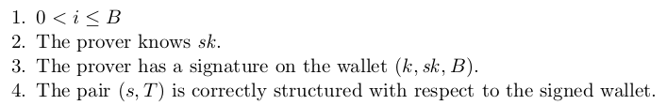
What is the Compact E-Cash?
Customer creates a temporary fixed-sized wallet (wCom) based on a tuple(k, sk, B) that can generate B number of coins
The wallet is to be signed by the merchant to confirm validity
  k = seed for pseudo random function F (basically initial value for a random function; pseudo randomness depends on its starting value)
  sk = the customer’s private key
  B = the number of coins in the wallet
Each coin has its tuple (s, T, π)
  s = serial number generated by the pseudo random function F_{k}(i); i is the current coin
  T = double spend tag
  π= interactive – zero knowledge proof

Slide 14
Compact E-cash continued
The idea is to label each spent coin/transaction with a serial number in the event that double spending occurs, it can be checked to see if the current serial number is found on a previous coin/transaction

Slide 15
Unidirectional version of Compact E-Cash
Implements a form of the Compact E-cash protocol with some minor edits
Customer makes ciphertexts of the coin tuples that they are going to use as from their actual wallet (Not reveal them yet)
  Merchant does not need to know what these contain, just that they are valid and that the customer do own them
Merchant signs the temporary wallet on Establish protocol rather than Init protocol

Slide 16
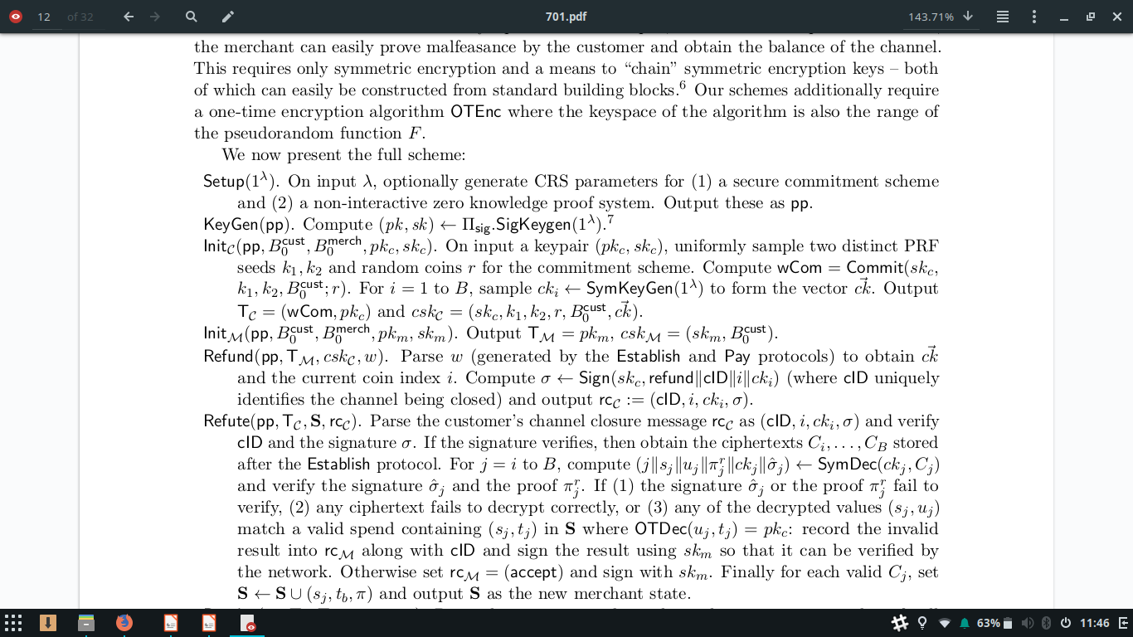
Unidirectional Scheme

Slide 17
Unidirectional Scheme : Setup the Commitment Scheme
Uses Pedersen’s commitment scheme that is published as pp (public parameter – something both parties can access)
  This generates 2 things:
    A CRS (common reference string) between the two parties
    A non interactive zero – knowledge proof system
I will explain this on the board:

Slide 18
Unidirectional Scheme : KeyGen
Computes a public/private key pair using the commitment earlier for both parties
Essentially pseudo keys/IDs for both parties

Slide 19
Unidirectional Scheme : Init
Customer
Merchant
B = 10
csk
State
csk
B₀
sk
{ }
B = 10
sk
k₁
k₂
r
B₀
ck[ ]
wCom
pk
pk
T_{C}
T_{M}
B₀ = customer’s initial channel balance
Total = 20 in channel

Slide 20
Unidirectional Scheme : Init
Both parties will agree on the respective initial channel balances: B_{o}
This will be released and verified as an escrow transaction
A coin vector will be generated from 1 to the total balance

Slide 21
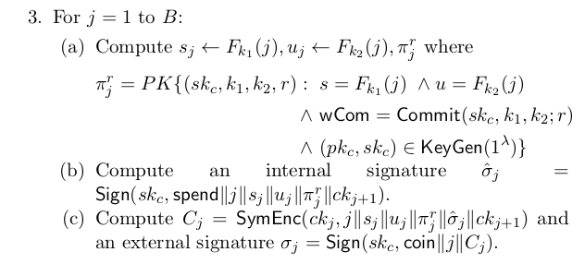
Unidirectional Scheme : Establish
wCom is your wallet commitment
This means that you want to prove that the wallet amount you want to use in the channel same as the initial balance you chose
  You commit is (sk_{C}, k₁, k₂; r)
Sign symmetrically encrypted coin tuples
Customer
csk
sk
k₁
k₂
r
B₀
ck[B]
wCom
pk
T_{C}

Slide 22
Unidirectional Scheme : Establish
Send proof of valid money that I have so the merchant can approve my channel wallet
Customer
Merchant
csk
State
csk
B₀
sk
{ }
sk
k₁
k₂
r
B₀
ck[B]
T_{C}( wCom, π)
wCom
pk
pk
T_{C}
T_{M}

Slide 23
Unidirectional Scheme : Establish
Takes customer token that contains wCom and its proof (π)
Verify the customer’s signature on Token (T_{C}) and its proof
Verify that B₀ = B by checking the j^{th} coin
Coin encryptions are considered “chained” (I assume this means that unlocking the j^{th} coin will produce the key to decrypt the j^{th} - 1 coin)
Merchant
csk
State
B₀
sk
{ }
pk
T_{M}
B = # of coins

Slide 24
Unidirectional Scheme : Establish
Customer
Merchant
wallet
csk
State
csk
B₀
sk
{ }
sk
sk (temp)
k₁
k₂
r
σ_{w} (M sig)
B
i = ck[1]
sk
k₁
k₂
r
B₀
ck[B]
wCom
pk
σ_{w} (Blind sig wallet)
pk
T_{C}
T_{M}
If checks done by the merchant is valid then send the customer’s temp wallet with a blind signature signed by the merchant
Else if something fails then abort channel

Slide 25
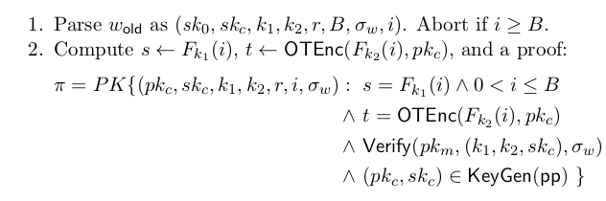
Unidirectional Scheme : Pay
I want 1 more month VPN
1 Coin per month
B = 10
Customer
Merchant
B = 10
wallet
State
C – 1
Coin Tuple:
(32, 41, π)
M + 1
{ }
sk
sk (temp)
k₁
k₂
r
σ_{w} (M sig)
B = 10
i =ck[1]
wCom
pk
pk
T_{C}
T_{M}

Slide 26
Unidirectional Scheme : Pay
Verifies π and make sure that (s,.,.) is not in State
In this example, State was initially empty and s in coin tuple is “32”
State then stores the coin tuple
Merchant’s R_{M} returns 1 (true)
R_{M} = payment success bit (boolean)
Merchant
State (new)
State
{ }
{(32,41,π)}
pk
T_{M}
C – 1
Coin Tuple:
(32, 41, π)
M + 1

Slide 27
Unidirectional Scheme : Pay
B = 9
Merchant
B = 11
Customer
Wallet (new)
wallet
State
{(32,41,π)}
sk
sk (temp)
k₁
k₂
r
σ_{w} (M sig)
B
i = ck[2]
sk
sk (temp)
k₁
k₂
r
σ_{w} (M sig)
B
i = ck[1]
wCom
pk
R_{M} return 1 (successful)
pk
T_{C}
T_{M}
Coin vector index ++ (essentially means make the next coin tuple the valid one)
Makes it very difficult to double spend

Slide 28
I want 1 more month VPN
1 Coin per month
B = 9
Merchant
B = 11
Customer
wallet
State
C – 1
Coin Tuple:
(29, 54, π)
M + 1
{(32,41,π)}
sk
sk (temp)
k₁
k₂
r
σ_{w} (M sig)
B = 9
i =ck[2]
wCom
pk
pk
T_{C}
T_{M}

Slide 29
Unidirectional Scheme : Pay
B = 8
B = 12
Customer
Wallet (new)
wallet
State
{(32,41,π),
(29, 54, π)}
sk
sk (temp)
k₁
k₂
r
σ_{w} (M sig)
B
i = ck[3]
sk
sk (temp)
k₁
k₂
r
σ_{w} (M sig)
B
i = ck[2]
wCom
pk
R_{M} return 1 (successful)
pk
T_{C}
T_{M}

Slide 30
Unidirectional Scheme : Closure
Both parties initiate their own protocol for closure
Customer runs Refund protocol to obtain the current coin index (current I) and request a rc_{M} (merchant’s channel closure message) from the merchant
  This protocol outputs a rc_{C} (customer’s channel closure message) that contains the channel closure ID, current coin index, the coin at the current coin index, and the customer’s signature
Merchant responds with its Refute protocol
  The merchant then verifies the signature, the unspent coins in the coin vector, and make sure that the same unspent coins are in the merchant’s State
  If valid, sign own rc_{M}, accept customer’s rc_{C}, and make sure the fake/temp money matches the ciphertext money sent in the beginning

Slide 31
Cheating?
During channel closure verification by the merchant, if any of the verification fails:
  Signature of the coins
  Proof of the coins
  Unable to decrypt ciphertexts
  Or double spending occurs
Merchant records the proof in its rc_{M}, signs it and lets the network confirm

Slide 32
Unidirectional Scheme : Resolve
Resolve protocol is now ran by the network to determine the final channel balance and determines the money sent to each party
Customer
Merchant
8 BTC
If valid
12 BTC
If cheating
12 BTC
8 BTC

Slide 33
Channel Type : Bidirectional
No longer giving coins
Transactions in both ways: Customer ← → Merchant
With each transaction the customer gets a new wallet that contains W(old wallet) – ε (amount exchanged) compared to Unidirectional that just deals with changing the coin amount in 1 wallet
*Customer closes the channel with a refund token given by the merchant

Slide 34
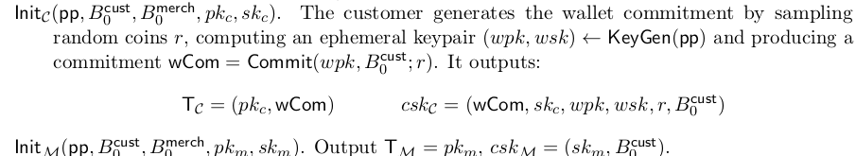
Bidirectional : Init
Setup’s the same
B = 10
csk
csk
B₀
sk
sk
wCom
wpk
wsk
r
B₀
wCom
pk
pk
T_{C}
T_{M}

Slide 35
Bidirectional : Establish
csk
csk
B₀
sk
sk
wCom
wpk
wsk
r
B₀
wCom
pk
T_{C}( wCom, π)
pk
T_{C}
T_{M}
Pretty much the same except you replace your keys (the ones in uni) with the temporary wallet’s keys

Slide 36
csk
csk
B₀
sk
sk
wCom
wpk
wsk
r
B₀
rt_{old}
wCom
pk
σ_{w} (Blind sig wallet)
pk
T_{C}
T_{M}
Total = 20 in channel

Slide 37
Bidirectional : Pay
State
{ }
ε, wCom, wpk, π
rt_{old}
wCom
pk
pk
T_{M}
T_{C}
The customer presents the merchant this copy of his old wallet (referenced by the wallet’s public key) as well as the amount (ε) that the customer wishes to change in the new wallet by (w_{new} - ε)

Slide 38
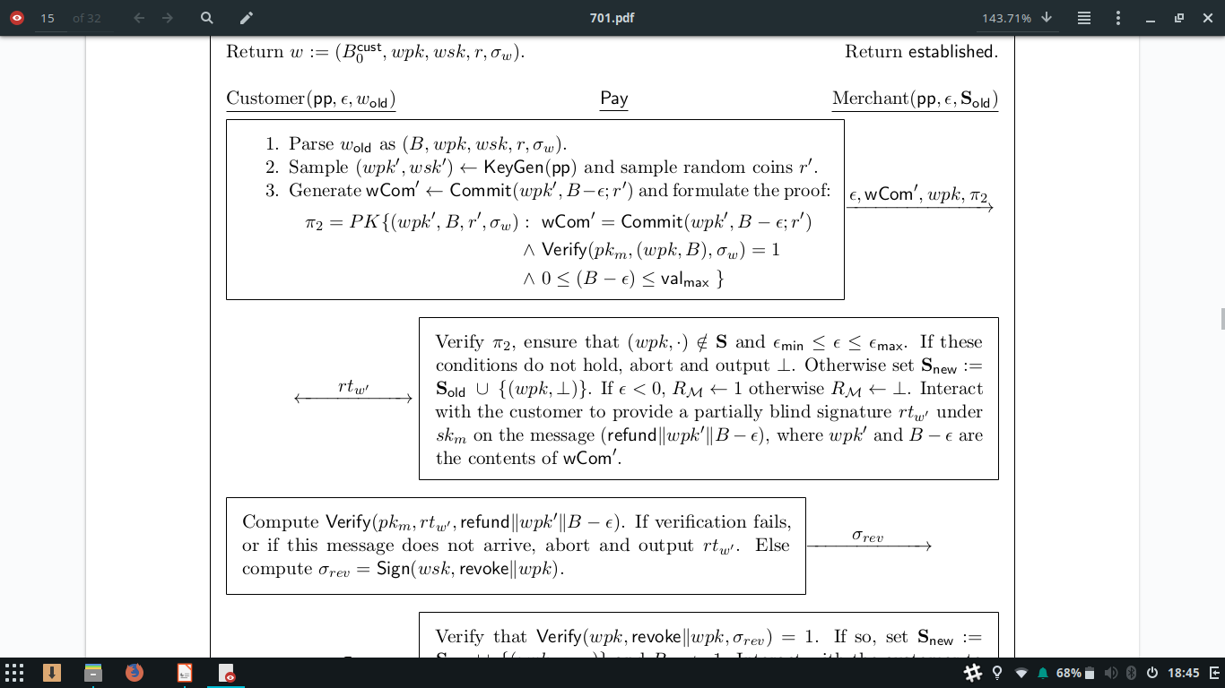
Bidirectional : Pay
Verify π , and check that the transaction amount fits between 0 and wallet[wallet.size]
If the below proof is unverifiable/valid, abort the transactions and output ⊥ (failure)
If the proof is verifiable, add the old wallet to your State and set it to ⊥ (void in this case)
  This really just means voiding the customer’s old wallet in your records
Merchant
State
State
(new)
{ }
{wpk_{old}, ⊥}
pk
T_{M}

Slide 39
Bidirectional : Pay
Merchant sends the customer a refund token denoted: rt_{new} that contains a partially blind signature of the merchant on the new requested wallet
Merchant
State
State
(new)
{ }
{wpk_{old}, ⊥}
pk
T_{M}

Slide 40
Bidirectional : Pay
Revoke your old wallet
State
{wpk_{old}, ⊥}
rt_{new} (refund token that contains new wallet values)
rt_{old}
wCom
pk
pk
T_{M}
T_{C}

Slide 41
Bidirectional : Pay
Customer takes the rt_{w} and verify that it is indeed from the merchant
If the verification is a success, the customer invalidates the old wallet by sending the merchant a signed revocation token
rt_{old}
wCom
pk
rt_{new}

Slide 42
Bidirectional : Pay
I revoked it!
State
{wpk_{old}, ⊥}
σ_{rev} (signed revocation message)
rt_{new}
wCom
pk
pk
rt_{old}
T_{M}
T_{C}

Slide 43
Bidirectional : Pay
Great!
Here’s your new wallet!
State
State (new)
σ_{w} (merchant authorizes new wallet by signing the new wallet and sending it over)
{wpk_{old}, ⊥}
{wpk_{old},σ_{rev} }
rt_{new}
wCom
pk
pk
T_{M}
T_{C}
Merchant verifies that the customer has revoked their old wallet

Slide 44
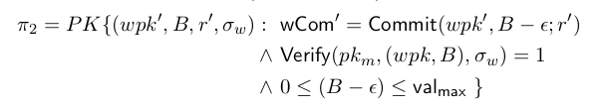
Bidirectional Pay Example
wCom = 20
State
{ }
ε, wCom, wpk, π
2, wCom, 32, π
rt_{old}
wCom
pk
pk
T_{M}
T_{C}

Slide 45
Bidirectional Pay Example
Revoke your old wallet
State
{32, ⊥}
rt_{new} (refund token that contains new wallet values)
rt_{old}
wCom
pk
pk
rt_{new}
T_{M}
T_{C}

Slide 46
I revoked it!
State
{32, ⊥}
σ_{rev} (signed revocation message)
rt_{new}
wCom
pk
pk
rt_{old}
T_{M}
T_{C}

Slide 47
wCom = 20 → 18
State
{(32, σ_{rev})}
w_{i} (new wallet) = 18
rt_{new}
wCom
pk
pk
T_{M}
T_{C}

Slide 48
wCom = 18
1 more!
State
{(32, σ_{rev}),}
ε, wCom, wpk, π
4, wCom, 74, π
rt_{new}
wCom
pk
pk
T_{M}
T_{C}

Slide 49
Revoke your old rt
wCom = 18
State
{(32, σ_{rev}),
(74, ⊥)}
rt_{new} (refund token that contains new wallet values)
rt_{old}
wCom
pk
pk
rt_{new}
T_{M}
T_{C}

Slide 50
Done!
Revoke your old rt
wCom = 18
State
{(32, σ_{rev}),
(74, σ_{rev})}
σ_{rev} (signed revocation message)
rt_{new}
wCom
pk
pk
rt_{old}
T_{M}
T_{C}

Slide 51
Here you go!
WCom = 18 → 14
State
{(32, σ_{rev}),
(74, σ_{rev})}
w_{i} (new wallet) = 14
rt_{new}
wCom
pk
pk
T_{M}
T_{C}

Slide 52
Bidirectional : Closure
Like Unidirectional
  Need rc from both parties to initiate channel closure and release to network for confirmation
This though, customer’s rc_{C} is reliant on the rt given by the merchant
  Customer signs the rt version given by the merchant and that gets outputted as rc_{C}
Merchant takes the customer’s rc_{C} and verifies that the rt in the rc is not an already revoked rt
  If the rt given is already revoked, then include it in the merchant’s rc_{M} and send it up to the network for the Resolve protocol

Slide 53
Bidirectional : Resolve
Network runs resolve and checks if the rc given are either valid or not
  If the customer’s rc is invalid, return ⊥ and give all the money in the channel to the merchant
  If both parties’ rc is invalid, reject the channel’s result

Slide 54
Indirect Payments
Bidirectional third party payments
A ← → I ← → B
“No purely cryptographic solution to this problem since it’s in essence fair exchange”
There are still ways to leak information of both parties due to abortion
“Fundamentally difficult to avoid in an interaction protocol”
Utilize blockchains for aborts: either processes the entire transaction from start to finish without errors or the entire transaction is voided (people get their money back)

Slide 55
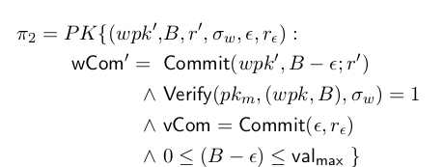
Customer
Merchant
Please send money to merchant
rt_{old}
rt_{old}
commit(ε, (C)wCom, wpk, π₂)
commit(ε, (C)wCom, wpk, π₂)
Node

Slide 56
Customer
Merchant
Please send money to merchant
rt_{old}
rt_{old}
commit(ε, (M)wCom_{new}, wpk, π_{B})
commit(ε, (M)wCom_{new}, wpk, π_{B})
Node

Slide 57
Customer
rt_{old}
commit(ε, (M)wCom_{new}, wpk, (C)wCom_{old}, π_{A})
rt_{old}
Node

Slide 58
Customer
Merchant
rt_{old}
rt_{old}
rt_{new}
crt_{new}
Refund token with condition that Customer revokes the old refund token
Node
Verify : commit(ε, (M)wCom_{new}, wpk, π_{B})

Slide 59
Customer revoke your rt_{old}
Customer
rt_{new}
rt_{old}
crt_{new}
Customer has 2 options:
Either sign revocation or cash out the current refund token
Node

Slide 60
Ok
Customer
rt_{new}
σ_{rev} (signed revocation message) for rt_{old}
crt_{new}
σ_{rev} (signed revocation message) for rt_{old}
Node

Slide 61
I revoke my crt
Customer
crt_{new}
rt_{new}
σ_{rev} (signed revocation message) for rt_{old}
This is still here because it is the refund token for the new wallet i.e the wallet with the transaction difference
σ_{rev} (signed revocation message) for crt_{new}
Node

Slide 62
Customer
rt_{new}
σ_{N} (signed new wallet)
(C)wCom_{new}
σ_{N} (signed new wallet)
(M)wCom_{new}
New wallets
Node

Slide 63
The transaction now must occur between A → I → B because I has the revocation tokens
If A tries to use a revoked refund token, the network will notice and punish A during Resolve protocol (punishment not specified)
If A does not revoke the refund token, then the channel closes no transaction of money occurs between the parties

Slide 64
Conclusion
There is a possible threat of anonymity and privacy tracking during a intermediary abort, which results in both the merchant and customer requesting refund from the network which can be linked
This threat is limited however through the use of anonymous/temporary coins with alternative identifiers
The malicious node can only call abort once per channel, and each channel creation results in its own unique IDs thus its mathematically difficult to link its customers and merchants
BOLT achieves anonymity and privacy quite well

Slide 65
References and Sources
https://en.bitcoin.it/wiki/Lightning_Network
https://www.youtube.com/watch?v=qTB8ViRY9Ps -Blind signatures
https://www.ece.cmu.edu/~ece734/fall2015/recitations/7-18734R-Commitments.pdf
Pedersen’s commitment scheme
https://cs.nyu.edu/courses/spring12/CSCI-GA.3210-001/lect/lecture14.pdfPedersen’s commitment schemes
Green, Matthew & Miers, Ian, (2016), Bolt: Anonymous Payment Channels for Decentralized Currencies
https://www.doc.ic.ac.uk/~mrh/330tutor/ch06.html - Discrete Logs
https://usa.visa.com/run-your-business/small-business-tools/retail.html
Visa’s transaction per second

